Slide 1
Loss Functions &
Gradient Descent
Optimizers

Slide 2
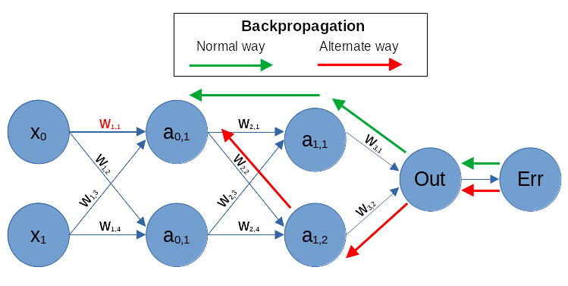
Working of Neural Networks
https://www.guru99.com/backpropogation-neural-network.html

Slide 3
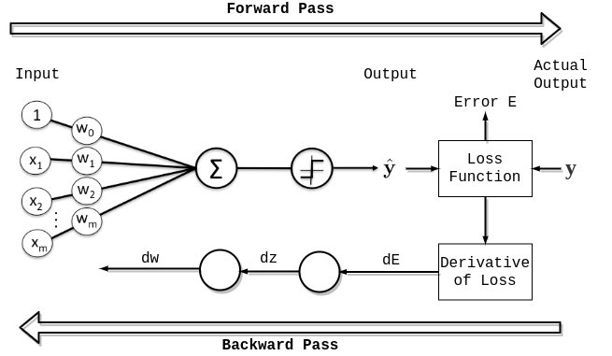
Loss function
Table of Content
What is a Loss Function?
How Loss Functions Work?
Types of Loss Functions
How to Choose the Right Loss Function?

Slide 4
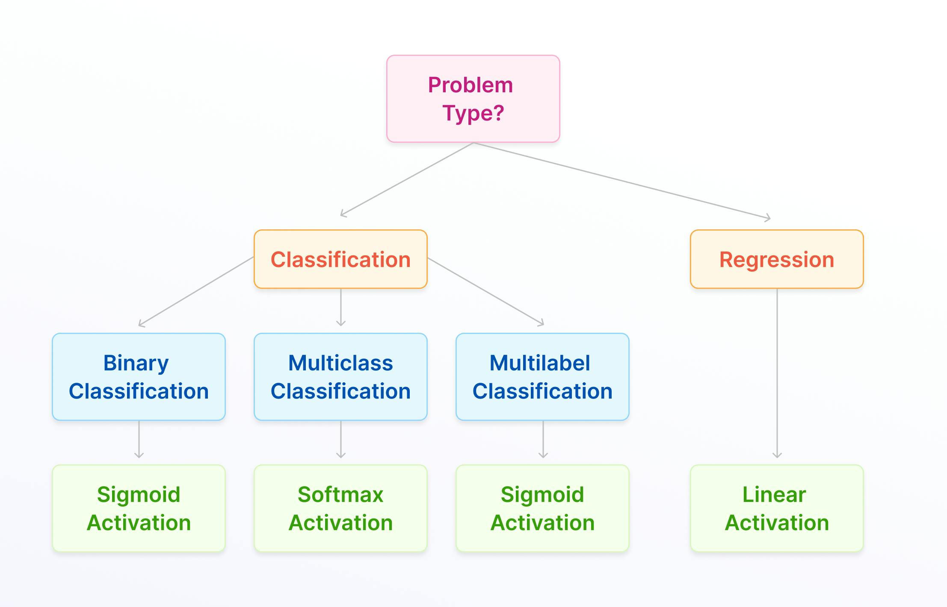

Slide 5
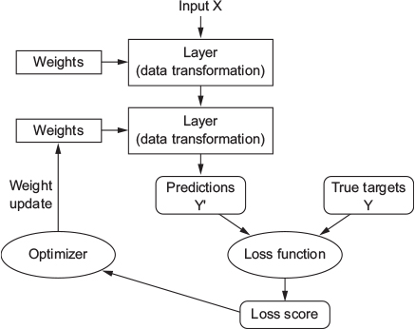
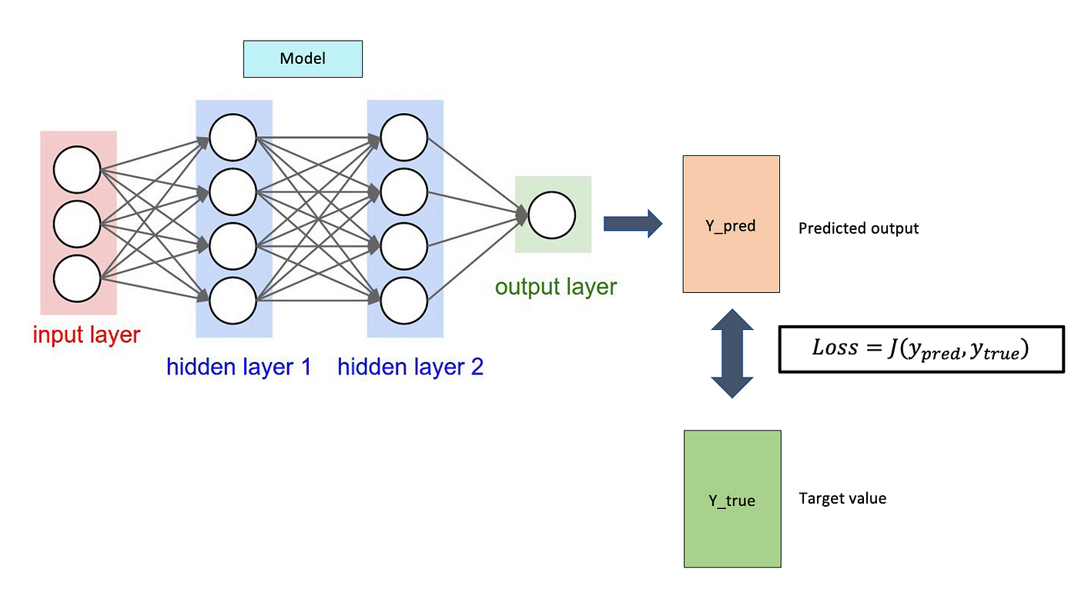

Slide 6
loss function
A loss function in machine learning is a mathematical function that measures how well a model's predictions match the actual results. It's also known as an error function.
A loss function quantifies how well or poorly a model is performing by computing the error between the predicted and actual values.
Goal: Minimize this loss to improve model accuracy.
Used in both traditional ML and neural networks (NNs).
Why is a loss function important?
It helps determine how well an algorithm models a dataset
It helps guide the learning process and improve a model's predictions
It helps optimize a model's parameters, such as weights and biases
Guide Model Training:
Measure Performance:
Influence Learning Dynamics:
How does a loss function work?
A loss function takes the predicted output and the actual output as input and generates a scalar value that quantifies the difference between the two outputs.
https://www.geeksforgeeks.org/loss-functions-in-deep-learning/

Slide 7
2. Types of Loss Functions
In classical ML models (e.g., Linear Regression, Logistic Regression, SVM, Decision Trees), the loss function is typically:
✅ For Regression:
Mean Squared Error (MSE):
Mean Absolute Error (MAE)
Huber Loss (Robust to outliers)
✅ For Classification:
Log Loss (Binary Cross-Entropy) → Used in Logistic Regression
Hinge Loss → Used in SVMs
3. Loss Functions in Neural Networks (Deep Learning)
Neural networks also use loss functions but in a more complex setup because of multiple layers and non-linear activations.
✅ For Regression (NNs):
Mean Squared Error (MSE)
Mean Absolute Error (MAE)
✅ For Classification (NNs):
Binary Cross-Entropy (for binary classification)
Categorical Cross-Entropy (for multi-class classification)
Sparse Categorical Cross-Entropy (for one-hot encoded multi-class labels)
https://www.geeksforgeeks.org/categorical-cross-entropy-in-multi-class-classification/
🔹 Key Difference: In deep learning, loss functions work with backpropagation & gradient descent, which is not always the case in traditional ML.
https://medium.com/data-science/optimization-loss-function-under-the-hood-part-iii-5dff33fa015d
https://medium.com/@devcharlie2698619/understanding-huber-loss-function-insights-from-applications-5c1c5145d2c4
https://www.geeksforgeeks.org/hinge-loss-relationship-with-support-vector-machines/

Slide 8
4. Are They the Same or Different?
Feature | Traditional ML Loss Function | Neural Network Loss Function
Purpose | Measures prediction error | Measures error but used in backpropagation
Usage | Used in simple models (e.g., Linear Regression, SVM) | Used in deep learning models (e.g., CNN, RNN)
Computation | Directly optimized | Combined with gradients & activation functions
Examples | MSE, Log Loss, Hinge Loss | MSE, Cross-Entropy, Huber, KL Divergence
✅ Conclusion: They are conceptually the same (both measure error), but NN loss functions are often more complex and integrated with gradient-based optimization.

Slide 9
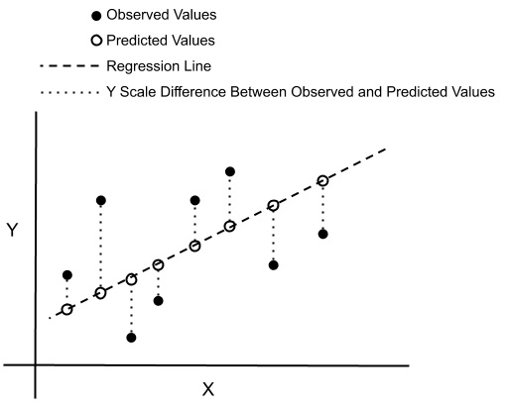
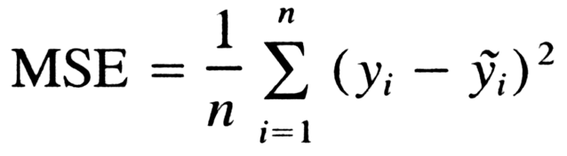
1.1 Mean Squared Error (MSE)
MSE measures the average squared difference between the actual and predicted values. It punishes large errors more than small ones.
📝 Explanation:
MSE squares the error to ensure positive values and amplify large errors.
It helps models learn smooth predictions but is sensitive to outliers (since large errors get squared).
💡 Use Cases:
✔ Predicting house prices
✔ Forecasting stock prices
✔ Estimating temperature trends
🌎 Real-World Example:
Predicting real estate prices based on features like area, location, and amenities.
A model predicting house price as $250K, while the actual price is $260K, results in an error of $10K² = $100M$.
✅ Pros:
✔ Simple and easy to compute.
✔ Works well when errors are normally distributed.
❌ Cons:
❌ Sensitive to outliers, as squared differences amplify large errors.
❌ Not robust when dealing with skewed data.
🛠 How to Overcome:
✔ Use Huber Loss or Log-Cosh Loss instead of MSE when outliers are present.
📍 Where to Use:
✅ Regression models with normally distributed errors.

Slide 10
How it's calculated:
For each data point, calculate the difference between the predicted value and the actual value.
Square each of these differences.
Calculate the average (mean) of these squared differences.
The formula is: MSE = (1/n) * Σ(yᵢ - ŷᵢ)² where:
n is the number of data points.
yᵢ is the actual value.
ŷᵢ is the predicted value.
Why it's used:
Regression tasks: MSE is commonly used as a loss function in regression problems, where the goal is to predict a continuous value.
Model evaluation: It can be used to evaluate the performance of regression models.
Differentiable: MSE is a differentiable function, which is important for optimization algorithms used in deep learning.
Penalizes large errors: Squaring the differences means that larger errors are penalized more heavily than smaller errors.

Slide 11
Interpretation:
A lower MSE value indicates that the model's predictions are closer to the actual values, suggesting better performance.
A higher MSE value indicates that the model's predictions are further away from the actual values, suggesting poorer performance.
Advantages:
Simple to understand and implement .
Differentiable .
Penalizes large errors more heavily .
Disadvantages:
Sensitive to outliers: Large errors can have a disproportionate impact on the MSE.
Not in the same units as the target variable: The MSE is in squared units, which can make it difficult to interpret in some cases.
Alternatives:
Mean Absolute Error (MAE): MAE is another common loss function that measures the average absolute difference between the predicted and actual values.
Root Mean Squared Error (RMSE): RMSE is the square root of the MSE, which is in the same units as the target variable.

Slide 12
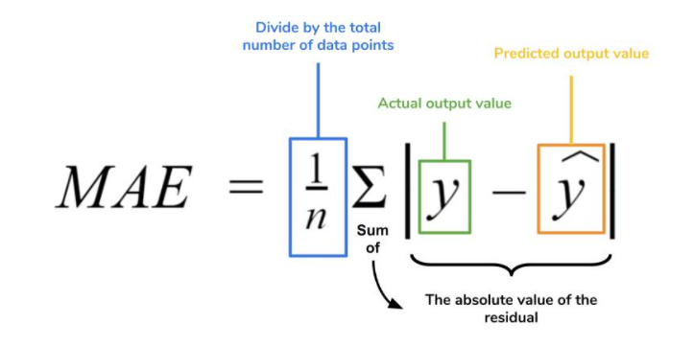
1.2 Mean Absolute Error (MAE)
MAE measures the average absolute difference between predicted and actual values. It treats all errors equally.
📝 Explanation:
Unlike MSE, errors are not squared, reducing sensitivity to outliers.
Errors are treated linearly, making it a more robust loss function.
💡 Use Cases:
✔ Predicting delivery times
✔ Forecasting energy consumption
🌎 Real-World Example:
Predicting arrival time for food deliveries.
If a predicted time is 30 min, but the actual time is 35 min, the absolute error is 5 min.
✅ Pros:
✔ Less sensitive to outliers than MSE.
✔ More interpretable (error values are in the same unit as the target variable).
❌ Cons:
❌ Harder to optimize due to non-differentiability at zero.
🛠 How to Overcome:
✔ Use Huber Loss, which combines MSE (for small errors) and MAE (for large errors).
📍 Where to Use:
✅ When outliers are present in the dataset.
💻 Code Implementation:
python
model.compile(optimizer='adam', loss='mae', metrics=['mse'])

Slide 13
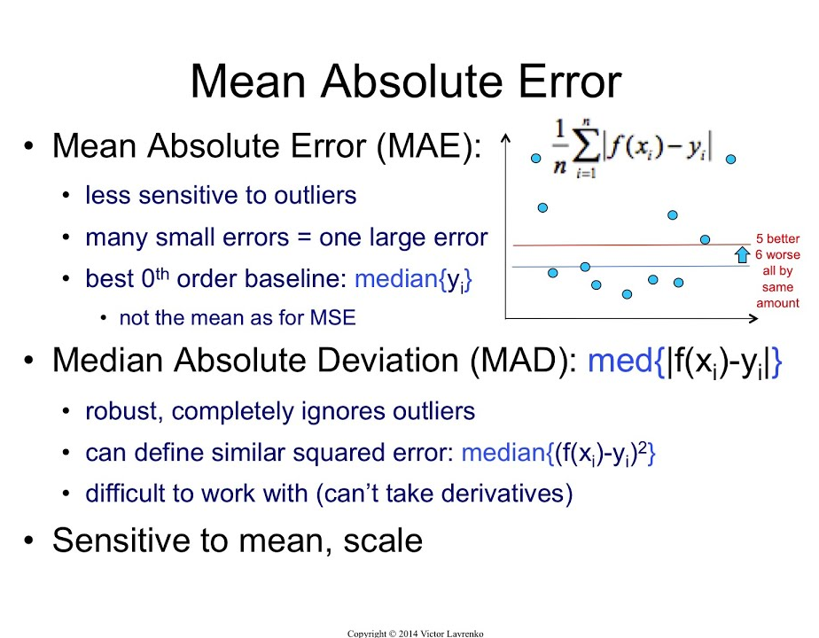
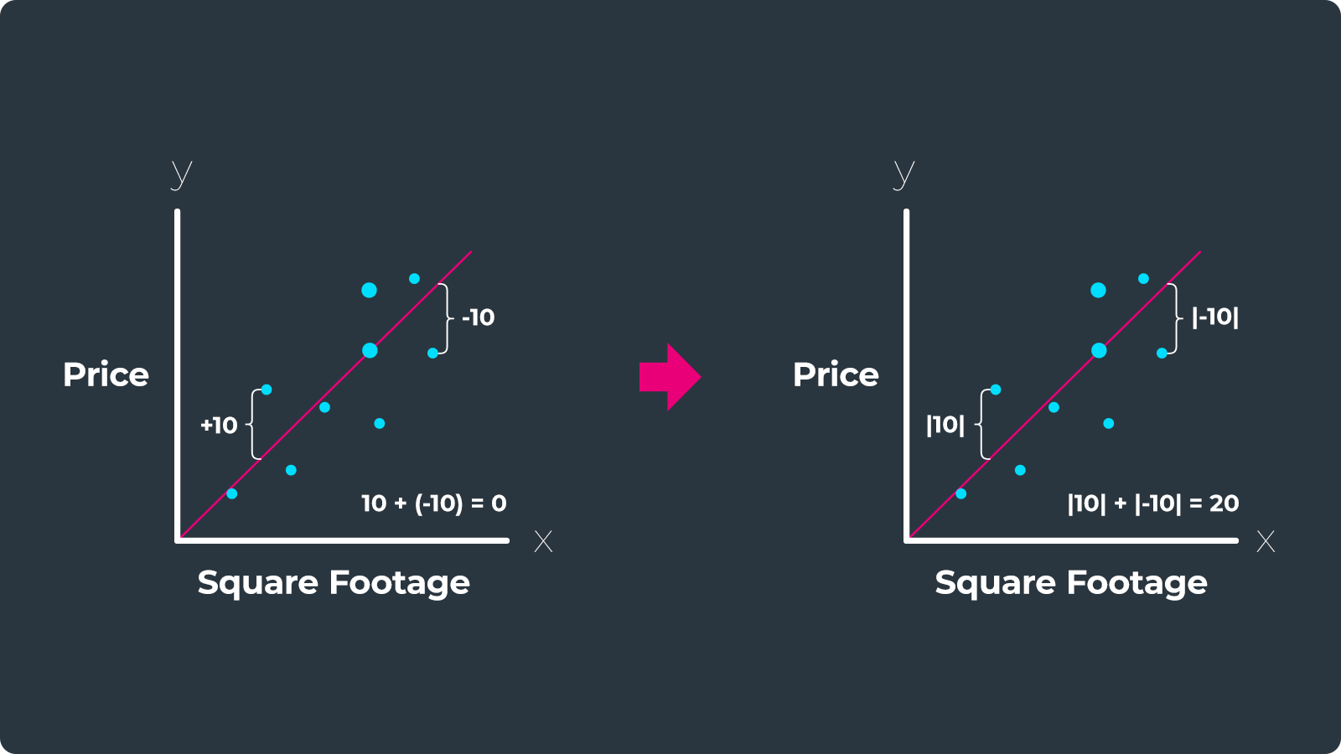

Slide 14
What it is:
MAE calculates the average of the absolute differences between the predicted and actual values, essentially measuring the magnitude of errors without considering their direction (overestimation or underestimation).
Why it's used:
Interpretability: MAE is easy to understand and interpret because it's in the same units as the target variable, making it simple to assess the magnitude of errors.
Robustness to Outliers: MAE is less sensitive to outliers compared to Mean Squared Error (MSE) because it doesn't penalize large errors as severely.
Regression Problems: MAE is commonly used as a loss function for regression problems, where the goal is to predict continuous values.
Relationship to other metrics:
MSE: MSE penalizes larger errors more heavily than MAE because it squares the differences, making it more sensitive to outliers.
RMSE: Root Mean Squared Error is the square root of MSE, and like MSE, it also penalizes large errors more heavily than MAE.
How to use it in deep learning:
Loss Function: MAE can be used as a loss function during model training, guiding the model to minimize the average absolute error.
Evaluation Metric: MAE can be used to evaluate the performance of a trained model on a test dataset.
Libraries: Libraries like TensorFlow and PyTorch provide functions to calculate MAE, making it easy to integrate into deep learning workflows.

Slide 15
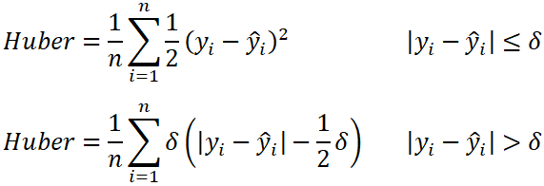
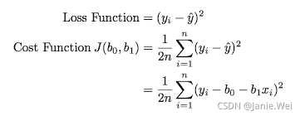
1.3 Huber Loss
Huber loss is a combination of MSE and MAE, reducing sensitivity to outliers.
📝 Explanation:
Uses MSE for small errors and MAE for large errors.
The threshold δ decides the transition between MSE and MAE behavior.
💡 Use Cases:
✔ Regression tasks with noisy data
✔ Forecasting stock prices
🌎 Real-World Example:
Self-driving cars predicting the correct steering angle.
Prevents extreme values from distorting predictions.
✅ Pros:
✔ Less sensitive to outliers than MSE.
✔ Smooth optimization with differentiability everywhere.
❌ Cons:
❌ Requires tuning of δ hyperparameter.
🛠 How to Overcome:
✔ Use Log-Cosh Loss, which automatically smooths extreme errors.
📍 Where to Use:
✅ When dealing with outliers but still requiring smooth optimization.
💻 Code Implementation:
model.compile(optimizer='adam', loss=tf.keras.losses.Huber(delta=1.0), metrics=['mae'])

Slide 16
Huber loss is a robust loss function in deep learning that combines the strengths of Mean Squared Error (MSE) and Mean Absolute Error (MAE), making it less sensitive to outliers than MSE while remaining differentiable. It transitions smoothly between quadratic and linear behavior based on a hyperparameter δ, penalizing small errors like MSE and large errors like MAE.
Here's a more detailed explanation:
Combines MSE and MAE:
Huber loss aims to leverage the advantages of both MSE (sensitive to small errors) and MAE (robust to outliers).
Robustness to Outliers:
By transitioning to a linear (MAE-like) behavior for large errors, Huber loss reduces the influence of outliers, making it more robust than MSE.
Differentiable:
Unlike MAE, Huber loss is differentiable, which is crucial for using it with gradient-based optimization algorithms.
Hyperparameter δ:
The hyperparameter δ (delta) determines the threshold at which the loss function switches from quadratic (MSE-like) to linear (MAE-like) behavior.
Formula:
When |y - f(x)| <= δ: L(y, f(x)) = 0.5 * (y - f(x))^2 (quadratic, like MSE)
When |y - f(x)| > δ: L(y, f(x)) = δ * (|y - f(x)| - 0.5 * δ) (linear, like MAE)
Where:
y is the true value
f(x) is the predicted value

Slide 17
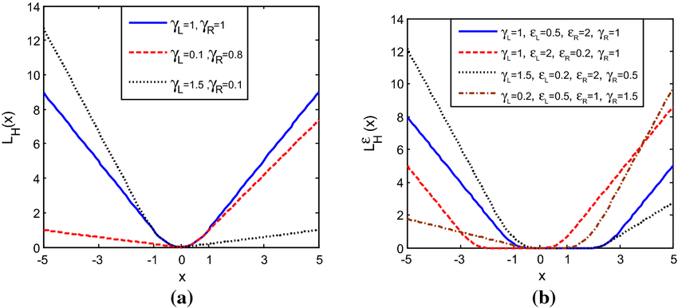
When to use:
Huber loss is particularly useful in regression tasks where the data might contain outliers or when you want a balance between penalizing small and large errors.
Advantages:
Robust to outliers
Differentiable
Balances MSE and MAE
Disadvantages:
Requires careful tuning of the hyperparameter δ
https://fastercapital.com/topics/the-huber-loss-function-and-its-application.html
https://medium.com/@devcharlie2698619/understanding-huber-loss-function-insights-from-applications-5c1c5145d2c4

Slide 18
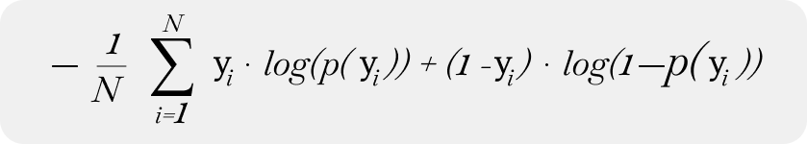
2. Loss Functions for Classification
Classification loss functions measure how different the predicted class probabilities are from actual class labels.
2.1 Binary Cross-Entropy (Log Loss)
Binary Cross-Entropy measures the difference between two probability distributions for binary classification tasks.
📝 Explanation:
Encourages correct predictions with high confidence.
Works well with sigmoid activation functions.
💡 Use Cases:
✔ Spam detection (spam vs. not spam)
✔ Fraud detection
🌎 Real-World Example:
Email spam filter predicting the probability of an email being spam.
If the model predicts 0.9 (90% chance of spam), but it's actually spam (1), the loss will be low.
✅ Pros:
✔ Works well for imbalanced datasets with class probabilities.
❌ Cons:
❌ Can lead to very high loss for overconfident wrong predictions.
🛠 How to Overcome:
✔ Use Focal Loss for handling imbalanced datasets.
📍 Where to Use:
✅ Binary classification tasks (fraud detection, sentiment analysis).
💻 Code Implementation:
model.compile(optimizer='adam', loss='binary_crossentropy', metrics=['accuracy'])

Slide 19
Binary Cross-Entropy (BCE), also known as log loss, is a loss function used in machine learning, particularly for binary classification problems, that measures the difference between predicted probabilities and actual binary labels, penalizing incorrect predictions more heavily.
Here's a more detailed explanation:
What it is:
Loss Function:
BCE is a loss function used to quantify the difference between a model's predictions and the true labels in binary classification tasks.
Binary Classification:
It's specifically designed for problems where there are only two possible outcomes (e.g., 0 or 1, yes or no, true or false).
Logarithmic Nature:
BCE's logarithmic nature means that it penalizes incorrect predictions more severely, especially when the model is highly confident in a wrong prediction.
Predicted Probabilities:
The model outputs a probability (between 0 and 1) representing the likelihood of the positive class, and BCE compares these probabilities with the actual binary labels (0 or 1).
Penalties:
A high predicted probability for the wrong class or a low predicted probability for the correct class results in a higher loss value.
https://www.analyticsvidhya.com/blog/2021/03/binary-cross-entropy-log-loss-for-binary-classification

Slide 20
Why it's used:
Training Neural Networks:
BCE is commonly used to train neural networks with a sigmoid activation function in the output layer, as the sigmoid function outputs values between 0 and 1, representing probabilities.
Logistic Regression:
BCE is also used in logistic regression, a statistical method for predicting the probability of a binary outcome.
Model Performance:
BCE helps to measure the performance of a classification model and guides the model to improve its accuracy during training by minimizing the dissimilarity between predicted probabilities and true labels.
Penalizing Incorrect Predictions:
The logarithmic nature of BCE ensures that incorrect predictions are penalized more heavily, which can be crucial in certain applications where misclassification can have significant consequences.
https://gombru.github.io/2018/05/23/cross_entropy_loss/

Slide 21
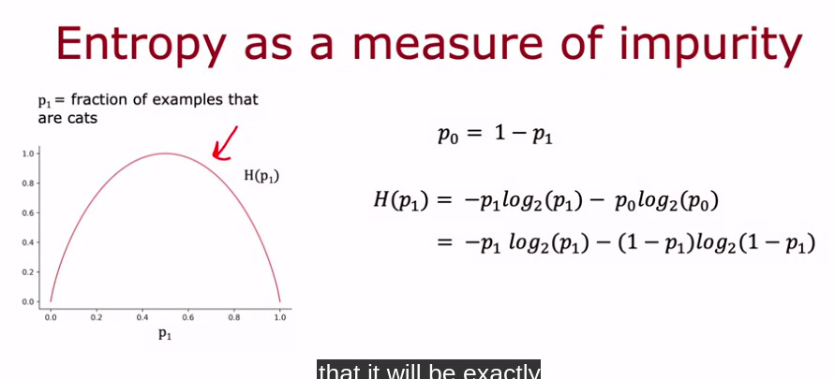
Formula:
The formula for BCE is:
L = -(y * log(p) + (1 - y) * log(1 - p))
Where:
L is the binary cross-entropy loss.
y is the true binary label (0 or 1).
p is the predicted probability of the positive class (between 0 and 1).
Example:
If the true label (y) is 1 and the predicted probability (p) is 0.9, the loss will be relatively low, indicating a good prediction.
If the true label (y) is 0 and the predicted probability (p) is 0.9, the loss will be high, indicating a poor prediction.
If the true label (y) is 1 and the predicted probability (p) is 0.1, the loss will be high, indicating a poor prediction.
In Summary:
BCE is a valuable loss function for binary classification tasks, especially when dealing with neural networks and logistic regression models, as it effectively measures the difference between predicted probabilities and true labels, guiding the model towards better performance.

Slide 22
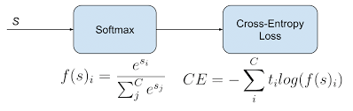
2.2 Categorical Cross-Entropy (CCE)
Categorical Cross-Entropy (CCE) calculates the difference between predicted and actual class probabilities for multi-class classification. It expects the true labels in one-hot encoded format.
📝 Explanation:
CCE penalizes the model more when it assigns low probability to the correct class.
Works well when classes are balanced and labels are one-hot encoded.
Uses softmax activation in the final layer to normalize predictions.
💡 Use Cases:
✔ Image Classification (e.g., ResNet, VGG, CNN models)
✔ Text Classification (e.g., Sentiment Analysis)
✔ Speech Recognition
🌎 Real-World Example:
Consider classifying an image into one of three categories: Dog, Cat, or Bird.
Actual label (one-hot encoded): [0, 1, 0] (It’s a cat).
Model prediction (softmax output): [0.1, 0.8, 0.1] (80% chance it’s a cat).
Loss is low because the predicted probability for the correct class (Cat) is high.
✅ Pros:
✔ Works well for multi-class classification with one-hot encoded labels.
✔ Encourages high confidence predictions for correct classes.
❌ Cons:
❌ Requires one-hot encoding, which increases memory usage for large datasets.
🛠 How to Overcome:
✔ If labels are integers instead of one-hot encoded, use Sparse Categorical Cross-Entropy instead.
📍 Where to Use:
✅ When labels are in one-hot encoded format.
Categorical Cross-Entropy (CCE), also known as Softmax Loss, is a loss function used in deep learning for multi-class classification problems where the output can be one of several mutually exclusive classes. It measures the difference between the predicted probability distribution and the true (one-hot encoded) distribution, guiding the model to minimize errors during training.
model.compile(optimizer='adam', loss='categorical_crossentropy', metrics=['accuracy'])
https://www.geeksforgeeks.org/categorical-cross-entropy-in-multi-class-classification/

Slide 23
Here's a more detailed explanation:
Multi-class Classification:
CCE is specifically designed for scenarios where the model needs to predict one class from a set of multiple options (e.g., classifying images into different objects).
One-Hot Encoding:
The true labels (ground truth) are typically represented in a one-hot encoded format, where a vector contains '1' for the correct class and '0' for all others.
Probability Distributions:
CCE compares the predicted probability distribution (outputted by a softmax activation function) with the true one-hot encoded distribution.
Loss Calculation:
The loss is calculated by summing the negative log-likelihoods of the predicted probabilities for the correct classes.
Softmax Activation:
CCE is often used in conjunction with a softmax activation function, which outputs a probability distribution over the classes.
Minimizing Loss:
During training, the model adjusts its weights to minimize the CCE loss, thus improving the accuracy of its predictions.
Sparse Categorical Cross-Entropy:
An alternative to CCE is Sparse Categorical Cross-Entropy. The difference between the two is in how the truth labels are defined. Categorical Cross-Entropy expects the true labels to be one-hot encoded, while Sparse Categorical Cross-Entropy expects the labels to be integers representing the class indices.

Slide 24
2. Sparse Categorical Cross-Entropy (SCCE)
📖 Definition:
Sparse Categorical Cross-Entropy (SCCE) is the same as Categorical Cross-Entropy, but it works when labels are integers instead of one-hot encoded vectors.
📌 Formula:
Same as CCE, but instead of using one-hot encoded labels, it directly uses integer class labels.
📝 Explanation:
Instead of [0, 1, 0], labels are stored as 1 (just the class index).
Useful when dealing with many classes, as it saves memory.
Still uses softmax activation for probability distribution.
💡 Use Cases:
✔ Large multi-class classification problems (e.g., ImageNet dataset with 1,000+ categories).
✔ Natural Language Processing (NLP) models (e.g., Word embeddings).
🌎 Real-World Example:
Classifying an image as Dog (0), Cat (1), or Bird (2).
Actual label:1 (Cat) instead of [0, 1, 0].
Predicted probabilities:[0.1, 0.8, 0.1].
Loss is still low because the probability for index 1 (Cat) is high.
Pros:
✔ More memory efficient than CCE because it doesn't require one-hot encoding.
✔ Works best for large datasets with many categories.
❌ Cons:
❌ Cannot be used if labels are already one-hot encoded.
🛠 How to Overcome:
✔ If labels are one-hot encoded, use Categorical Cross-Entropy instead.
📍 Where to Use:
✅ When labels are stored as integers (not one-hot encoded).
💻 Code Implementation (TensorFlow/Keras):
model.compile(optimizer='adam', loss='sparse_categorical_crossentropy', metrics=['accuracy'])
https://www.geeksforgeeks.org/sparse-categorical-crossentropy-vs-categorical-crossentropy/
https://medium.com/@shireenchand/choosing-between-cross-entropy-and-sparse-cross-entropy-the-only-guide-you-need-abea92c84662

Slide 25
Key Differences:
Feature | Categorical Cross-Entropy | Sparse Categorical Cross-Entropy
Label Format | One-hot encoded (e.g., [0, 1, 0]) | Integer encoded (e.g., 1)
Memory Usage | Higher (stores full one-hot vectors) | Lower (stores a single integer per label)
Performance | Works well for small-medium class sizes | Best for large class sizes
Softmax Needed? | Yes | Yes
Best For | Small to medium datasets (e.g., CIFAR-10) | Large datasets with many classes (e.g., ImageNet)
Which One Should You Use?
If labels are one-hot encoded → Use Categorical Cross-Entropy.
If labels are integers → Use Sparse Categorical Cross-Entropy.
For large datasets with many classes → Use Sparse CCE for better memory efficiency.

Slide 26
More Loss Functions to Explore:
Categorical Cross-Entropy → Used for multi-class classification.
Sparse Categorical Cross-Entropy → Same as categorical cross-entropy but used for integer labels.
Dice Loss → Used for image segmentation tasks.
Triplet Loss → Used in face recognition models.
Summary Table
Loss Function | Use Case | Best For | Handling Outliers?
MSE | Regression | General Predictions | ❌ No
MAE | Regression | Robust Predictions | ✅ Yes
Huber Loss | Regression | Noisy Data | ✅ Yes
Binary Cross-Entropy | Binary Classification | Probabilistic Outputs | ❌ No
Categorical Cross-Entropy | Multi-Class Classification | Image Classification | ❌ No

Slide 27
Gradient Descent
https://www.geeksforgeeks.org/data-science/what-is-gradient-descent/
https://www.geeksforgeeks.org/optimization-rule-in-deep-neural-networks/
Revisiting Gradient Descent, Momentum Optimizer, RMSProp, Adam

Slide 28
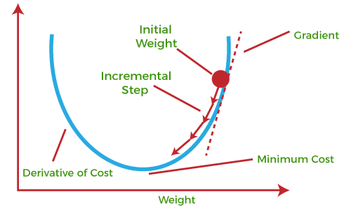
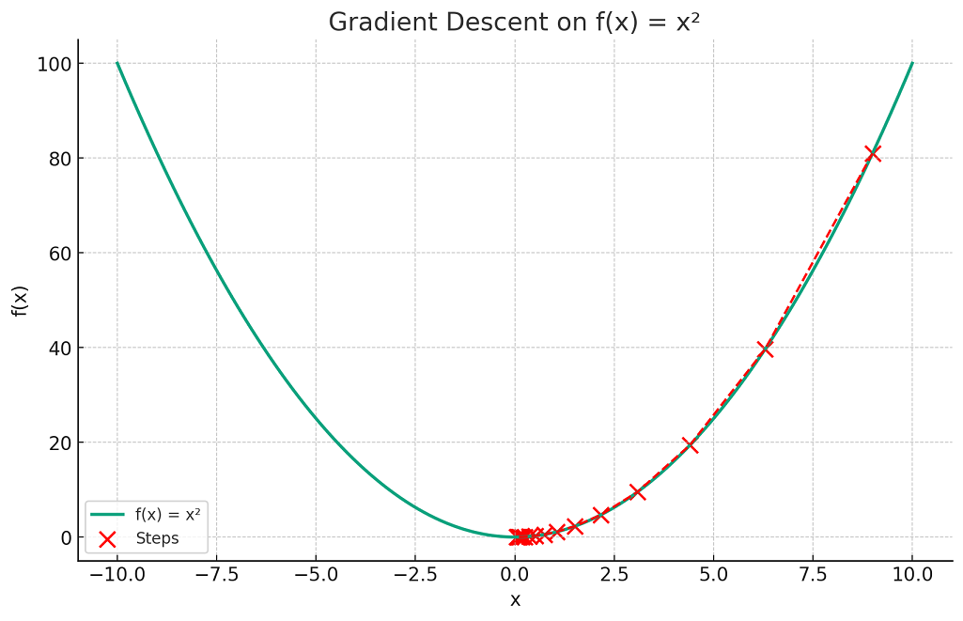
Gradient Descent
The gradient descent algorithm is an optimization algorithm used to minimize an objective function, commonly called the cost or loss function in machine learning. This cost function is a mathematical function used to calculate loss or error which is the difference between the model’s predicted value and the actual value in the real world for a given input data set.
term “gradient descent” is derived from two key concepts: “gradient” and “descent.”
Gradient: In mathematics and physics, the gradient of a function at any point is a multi-dimensional vector that points in the direction of the steepest increase of that function.
Descent: The word “descent” refers to the method’s objective of moving downwards to find the minima of the function.
https://www.mathsisfun.com/gradient.html
https://vitalflux.com/gradient-descent-explained-simply-with-examples/
https://www.coursera.org/articles/what-is-gradient-descent

Slide 29
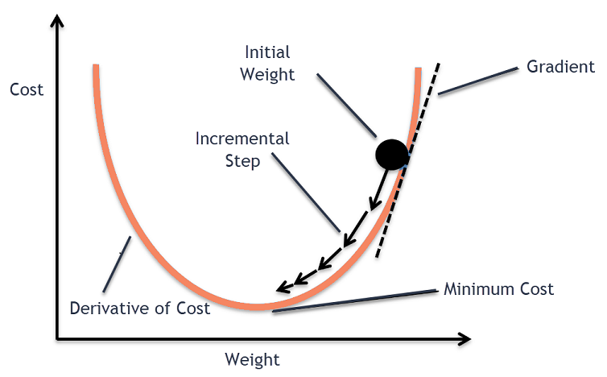
Gradient Descent in Machine Learning vs. Deep Learning: Same or Different?
✅ Short Answer:Conceptually the same (both optimize a loss function by updating parameters), but in deep learning, gradient descent works with backpropagation and complex architectures.
1. What is Gradient Descent?
Gradient Descent is an optimization algorithm used to minimize a loss function by iteratively updating model parameters (weights and biases).
Goal: Find the optimal parameters that minimize the error.
Used in both traditional ML and deep learning models.
2. Gradient Descent in Traditional Machine Learning
🔹 Used in models like Linear Regression, Logistic Regression, SVM, etc.
🔹 Involves fewer parameters (only a few weights).
🔹 Can use closed-form solutions (e.g., Normal Equation in Linear Regression) when feasible.
✅ Example: Gradient Descent in Linear Regression
w=w−η⋅∂∂wJ(w)w = w - \eta \cdot \frac{\partial}{\partial w} J(w)
where:
ww = model weights
η\eta = learning rate
J(w)J(w) = loss function

Slide 30
3. Gradient Descent in Deep Learning
🔹 Used in neural networks (CNNs, RNNs, Transformers, etc.).
🔹 Works with millions of parameters (weights, biases in multiple layers).
🔹 Uses Backpropagation to compute gradients efficiently.
🔹 Requires GPU acceleration for large models.
✅ Example: Gradient Descent in Neural Networks (with Backpropagation)
Compute forward pass (calculate activations).
Compute loss using a loss function.
Backpropagation: Calculate gradients of loss w.r.t. each weight using chain rule.
Update weights using: w(l)=w(l)−η⋅∂∂w(l)J(w)w^{(l)} = w^{(l)} - \eta \cdot \frac{\partial}{\partial w^{(l)}} J(w) (where ll is the layer index)
4. Are They the Same or Different?
Feature | Gradient Descent in ML | Gradient Descent in Deep Learning
Usage | Optimizes models like Linear/Logistic Regression, SVMs | Optimizes Neural Networks (CNNs, RNNs, Transformers)
Complexity | Few parameters (simple weight updates) | Millions of parameters (complex backpropagation)
Training Time | Fast, can use closed-form solutions | Slow without GPUs, requires batch updates
Backpropagation? | ❌ No backpropagation needed | ✅ Uses backpropagation for weight updates
Memory Usage | Low | High (due to multiple layers)
✅ Conclusion: Same fundamental concept, but deep learning gradient descent is more complex due to backpropagation and large parameter spaces.

Slide 31
GRADIENT CODE
importnumpy as np
importmatplotlib.pyplot as plt
# Defining a simple quadratic function and its derivative
f =lambdax: x**2
f_prime =lambdax: 2*x
# Generating values
x =np.linspace(-10, 10, 400)
y =f(x)
# Gradient descent settings
learning_rate =0.15
x_start =9 # Starting point
steps =[x_start]
n_iterations =15
# Gradient Descent Iteration
for_ in range(n_iterations):
x_start =x_start -learning_rate *f_prime(x_start)
steps.append(x_start)
# Plotting the function
plt.figure(figsize=(10, 6))
plt.plot(x, y, lw=2, label=&amp;quot;f(x) =x²&amp;quot;)
# Plotting the steps
plt.scatter(steps, f(np.array(steps)), color='red', s=100, label='Steps')
plt.plot(steps, f(np.array(steps)), color='red', linestyle='--', lw=1.5)
# Annotations and labels
plt.title('Gradient Descent on f(x) = x²')
plt.xlabel('x')
plt.ylabel('f(x)')
plt.legend()
plt.grid(True)
plt.show()

Slide 32
The main types of gradient descent algorithms are
1. batch gradient descent
2. stochastic gradient descent (SGD)
3. mini-batch gradient descent
Each differing in how they update model parameters during training.

Slide 33
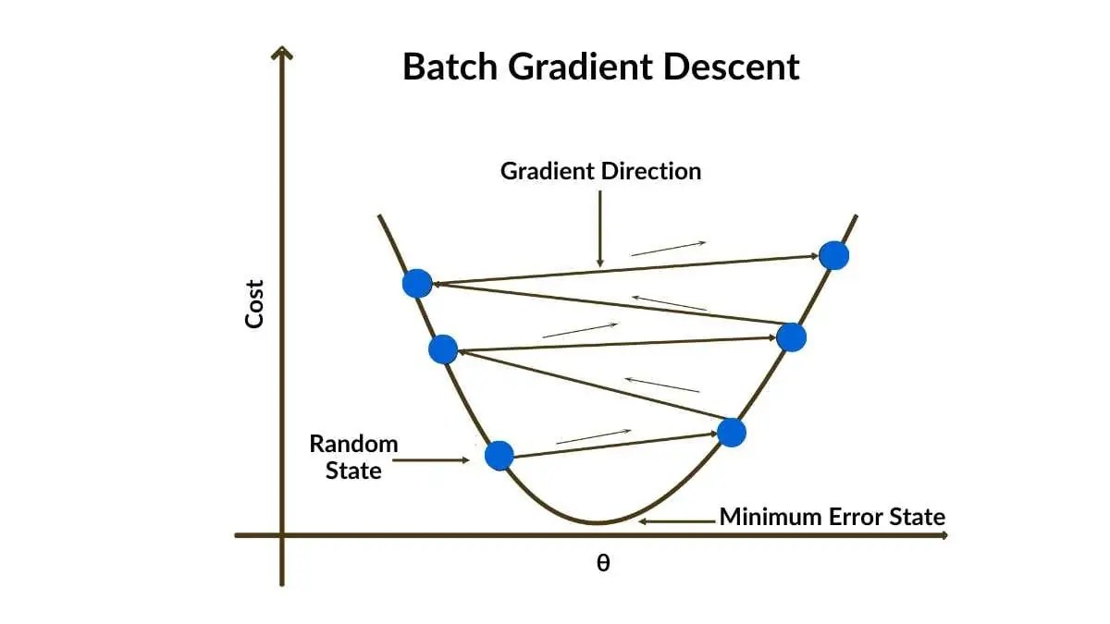
1. Batch Gradient Descent:
This method calculates the error for each example in the entire training dataset and only updates the pavery slow for large datasets as it requires processing the entire dataset for each iteration.
rameters after evaluating all examples.
Pros:
Guarantees convergence to a global minimum for convex functions, and is more stable than SGD.
Cons:
Can be
How it works:
BGD calculates the average gradient of the cost function across all training examples.
It then updates the model's parameters in the opposite direction of the calculated gradient.
This process repeats for a specified number of iterations (epochs).
The model parameters are updated only once per epoch, after all training examples have been evaluated.
Advantages:
Stable error gradient and convergence: BGD typically produces a stable error gradient and convergence, meaning the algorithm tends to converge to a stable solution.
.

Slide 34
Disadvantages:
Slow for large datasets: BGD can be slow and memory-intensive when dealing with large datasets, as it requires storing and processing the entire dataset in memory.
Potential for local minima: While BGD generally converges to a stable solution, it may sometimes get stuck in local minima, which are not the optimal solutions.
Variants:
Stochastic Gradient Descent (SGD): SGD updates parameters after processing each training example, leading to faster but potentially noisier convergence.
Mini-batch Gradient Descent: This method finds a balance between SGD and BGD by processing the data in small batches, updating the parameters after each batch.
https://medium.com/data-science/batch-mini-batch-stochastic-gradient-descent-7a62ecba642a

Slide 35
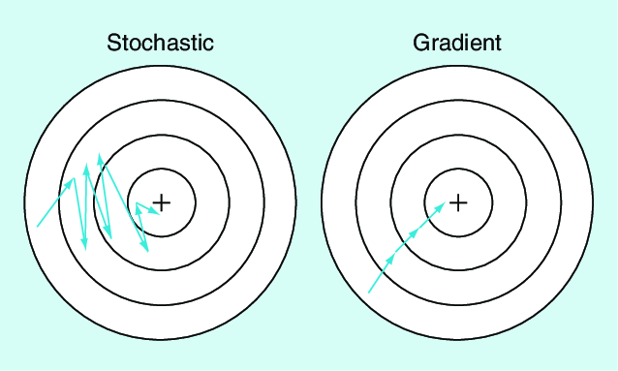
2. Stochastic Gradient Descent (SGD):
Updates the model parameters for each training example individually.
Pros:
Faster than batch gradient descent, especially for large datasets, and can escape local minima more easily.
Cons:
Can be noisy and may not converge to the global minimum, and can oscillate around the minimum.
Stochastic Gradient Descent (SGD) is an optimization algorithm used in deep learning to train models efficiently, particularly for large datasets, by updating model parameters using a randomly selected subset of data points (or a single data point) instead of the entire dataset at once.
Here's a more detailed explanation:
What it is:
SGD is a variant of the gradient descent algorithm, which is used to minimize a loss function in machine learning models.
How it works:
Unlike traditional gradient descent, which uses the entire dataset to calculate the gradient and update model parameters, SGD updates the parameters using only a small batch (or a single data point) at a time.

Slide 36
Why it's used:
Computational Efficiency: SGD is computationally efficient, especially for large datasets, as it avoids processing the entire dataset for each parameter update.
Faster Convergence: SGD can lead to faster convergence compared to traditional gradient descent, as it updates the parameters more frequently.
Suitable for Large Datasets: SGD is well-suited for training models on large datasets where processing the entire dataset at once would be computationally infeasible.
Drawbacks:
Noisy Updates: SGD introduces more noise into the learning process, which can lead to less stable convergence compared to traditional gradient descent.
Potential for Oscillations: The noisy updates can cause the algorithm to oscillate around the optimal solution, potentially slowing down convergence.
Variants of SGD:
Mini-batch SGD: This variant uses small batches of data points instead of a single data point, which can help reduce the noise and improve stability.
SGD with Momentum: This variant adds a momentum term to the update rule, which helps the algorithm to move faster and more smoothly towards the optimal solution.
Applications:
SGD is widely used in various deep learning tasks, including:
Image Recognition: Training convolutional neural networks (CNNs) for tasks like image classification and object detection.
Natural Language Processing (NLP): Training models for tasks like text classification, machine translation, and sentiment analysis.
Reinforcement Learning: Training models for tasks like game playing and robotics.

Slide 37
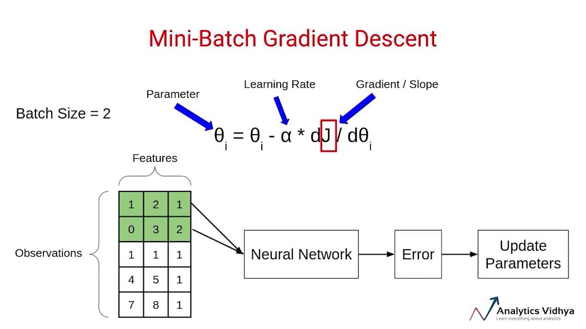
3. Mini-Batch Gradient Descent:
Combines the strengths of batch and stochastic gradient descent by updating parameters using small batches of data (instead of one or all examples).
How Mini-Batch Gradient Descent Works.
Splitting the Data: The training dataset is divided into smaller mini-batches. Each mini-batch contains a subset of data points. For example, if the dataset has 10,000 examples, we might split it into 100 mini-batches, each containing 100 data points.
Pros:
A good compromise between the speed of SGD and the stability of batch gradient descent, and is often the preferred method in practice.
Cons:
Requires careful selection of batch size, which can impact performance.
https://www.geeksforgeeks.org/mini-batch-gradient-descent-in-deep-learning/

Slide 38
How it works:
Instead of processing the entire dataset at once (like in batch gradient descent) or individual data points (like in stochastic gradient descent), mini-batch gradient descent divides the data into smaller batches.
For each batch, it calculates the gradient of the loss function with respect to the model's parameters (weights).
Then, it updates the parameters using these gradients.
This process is repeated iteratively until the model converges to a satisfactory solution.
Why it's used:
Computational Efficiency: Processing mini-batches is faster than processing the entire dataset in each iteration, leading to faster training times.
Stability: Mini-batch gradient descent provides a more stable update process compared to stochastic gradient descent, which can be noisy due to using only one data point per iteration.
Hardware Optimization: It allows for better utilization of parallel computing power, especially on GPUs, as matrix operations can be performed efficiently on mini-batches.
Relationship to other gradient descent methods:
Batch Gradient Descent: Uses the entire dataset to calculate the gradient in each iteration, leading to more accurate but slower updates.
Stochastic Gradient Descent (SGD): Uses a single data point to calculate the gradient in each iteration, leading to faster but potentially less stable updates.
Mini-batch gradient descent strikes a balance between the two, offering a good trade-off between speed and stability .

Slide 39
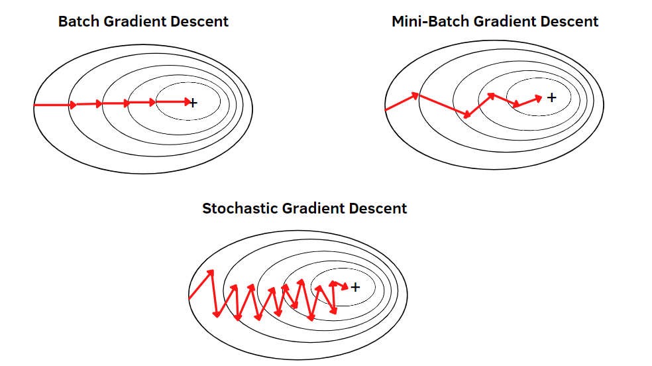
https://blog.skz.dev/gradient-descent

Slide 40
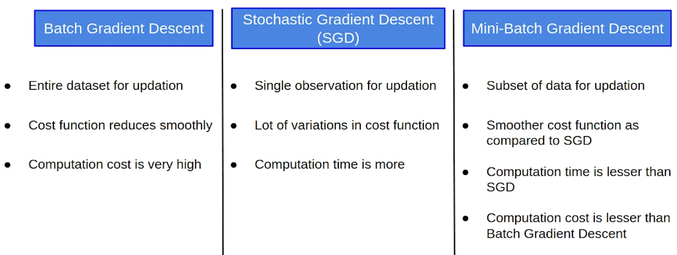
Computation time is more in sgd and Computation cost is very high in batch what it means
SGD: Fast per-iteration, but may take more iterations (more time overall) and can be noisy due to updates based on individual samples. Works well for very large datasets and can be parallelized or used in online settings.
Batch Gradient Descent: More stable per iteration but computationally expensive, especially with large datasets. Can converge faster in terms of number of epochs but may take a long time per epoch.

Slide 41
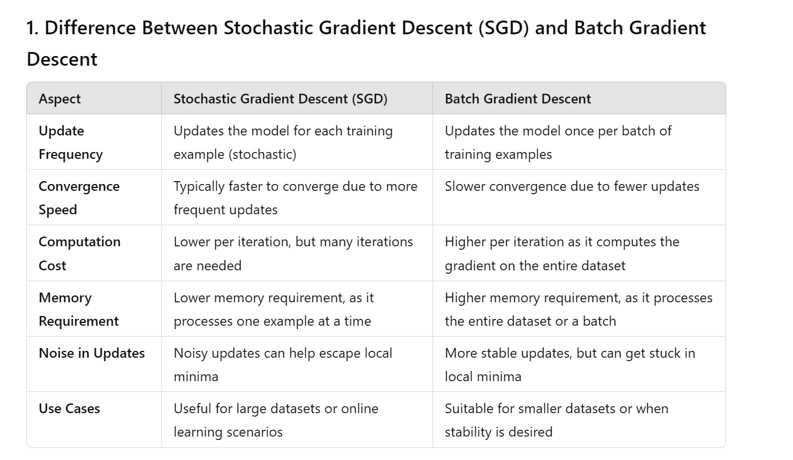

Slide 42
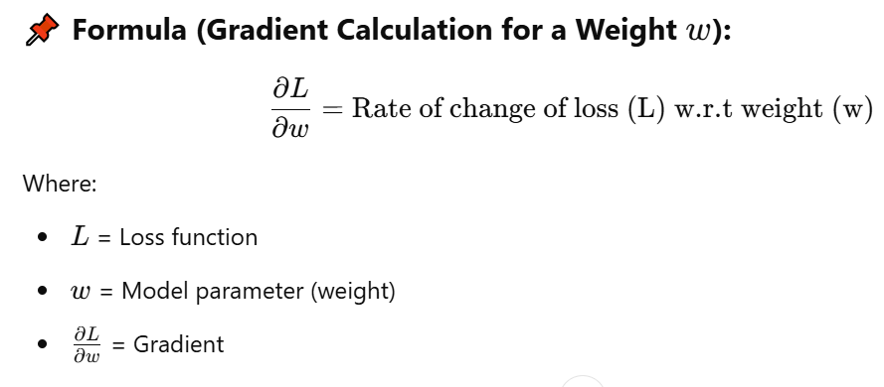
1. What is a Gradient?
A gradient is the derivative of the loss function with respect to the model's parameters (weights and biases). It represents the direction and magnitude of change needed to minimize the loss function.
The gradient tells us how much to update each parameter (weight/bias) to minimize the loss.
It is computed using backpropagation and is used by optimizers to update model weights.
2. What is an Optimizer?
An optimizer is an algorithm that uses gradients to update the model's parameters efficiently.
📝 Explanation:
The optimizer decides how much to adjust weights based on the gradient and learning rate.
Different optimizers use gradients differently to improve convergence speed and avoid issues like getting stuck in local minima.
📍 Key Optimizers and How They Use Gradients:
Optimizer | How it Uses Gradients
Gradient Descent (GD) | Updates weights using the full dataset’s gradient.
Stochastic Gradient Descent (SGD) | Updates weights using a single random data point’s gradient.
Mini-batch SGD | Updates weights using a small batch of data points.
Momentum | Uses past gradients to accelerate convergence.
Adam | Adjusts learning rate for each weight dynamically.
RMSprop | Normalizes gradients to prevent oscillations.
Real-World Example:
Imagine you're hiking down a mountain (loss function), and you want to find the lowest point (minimum loss).
The gradient tells you which direction to step in to descend faster.
The steeper the slope, the bigger the step (larger gradient).

Slide 43
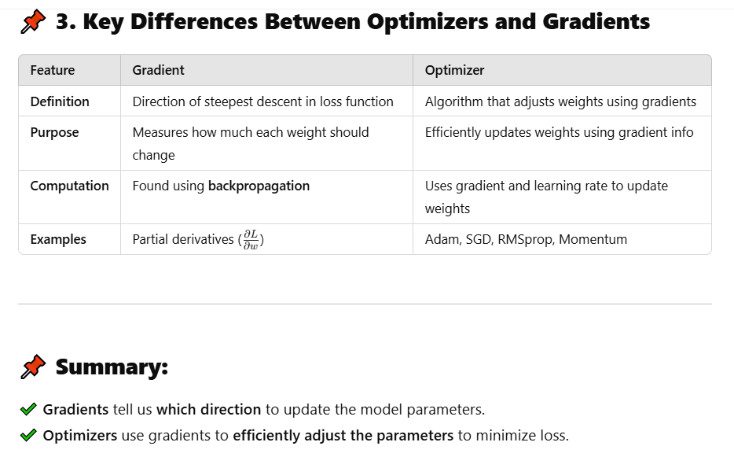

Slide 44
OPTIMIZERS IN DEEP LEARNING
https://www.scaler.com/topics/deep-learning/optimizers-in-deep-learning/

Slide 45
Optimizers in Deep Learning
1. What is an Optimizer?
An optimizer is an algorithm that adjusts the weights and biases of a neural network to minimize the loss function and improve model performance.
✔ Goal: Update model parameters using gradients computed via backpropagation.
✔ Optimizers control learning speed, convergence stability, and generalization.
2. Types of Optimizers in Deep Learning
Optimizers are mainly categorized into two types:
An optimizer is an algorithm that adjusts the model's weights and biases to minimize the loss function efficiently. It does this using the gradients computed during backpropagation.
📌 Why Do We Need Optimizers?
In deep learning, the goal is to minimize the loss function, which measures how far the predicted output is from the actual output. Optimizers help by:
Adjusting weights efficiently to reduce the loss.
Speeding up convergence to an optimal solution.
Avoiding problems like local minima and vanishing gradients.
Optimizer | How it Uses Gradients
Gradient Descent (GD) | Updates weights using the full dataset’s gradient.
Stochastic Gradient Descent (SGD) | Updates weights using a single random data point’s gradient.
Mini-batch SGD | Updates weights using a small batch of data points.
Momentum | Uses past gradients to accelerate convergence.
Adam | Adjusts learning rate for each weight dynamically.
RMSprop | Normalizes gradients to prevent oscillations.
Type | Description | Examples
First-order optimizers | Use first-order derivatives (gradients) | SGD, Momentum, RMSprop, Adam
Second-order optimizers | Use second-order derivatives (Hessian matrix) for curvature | Newton’s Method, L-BFGS (less common in deep learning)
📌 Types of Optimizers
Optimizers can be broadly classified into:
Basic Gradient Descent Methods
Adaptive Learning Rate Methods

Slide 46
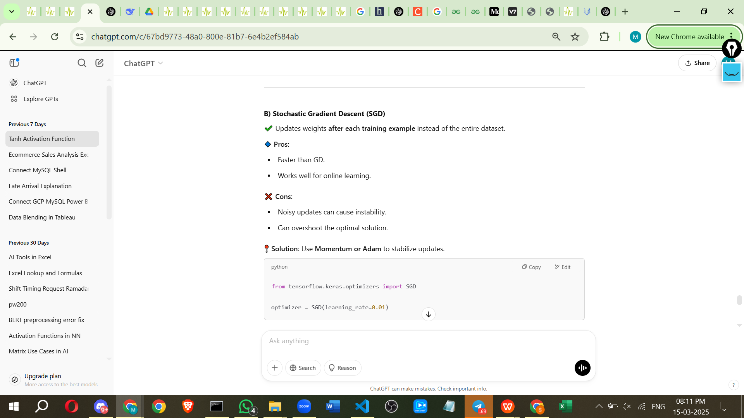
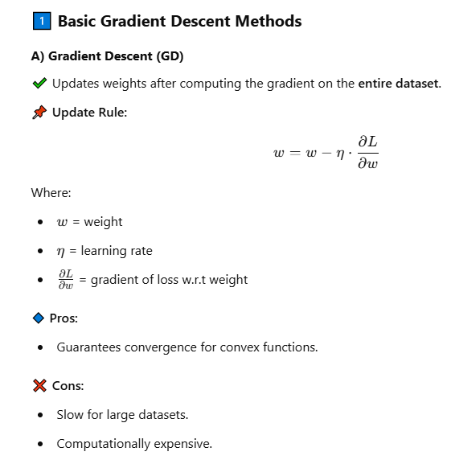
3. Popular Optimizers in Deep Learning
✔ Pros: Simple, works well for small datasets.
✔ Cons: Can be slow, struggles with noisy gradients.
✅ Variant:Mini-batch SGD (faster, more stable).

Slide 47
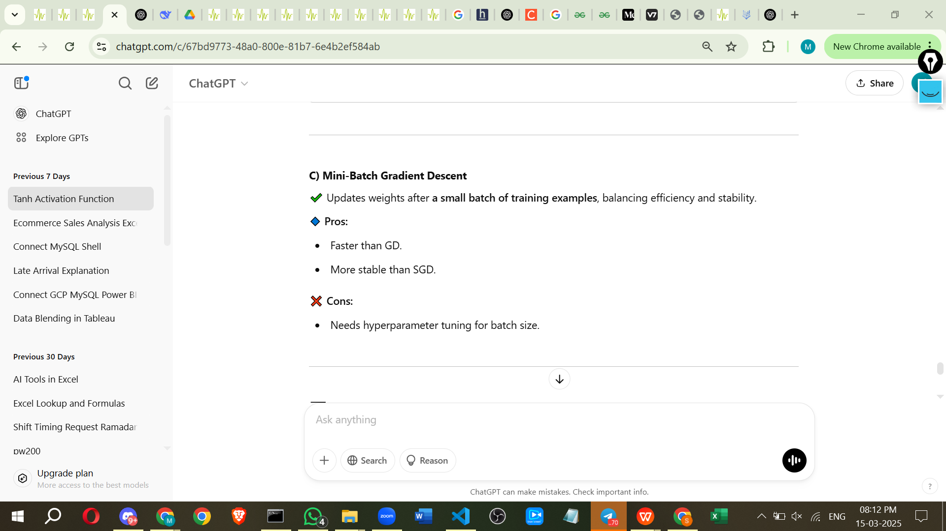
🔹 (2) SGD with Momentum
✔ Adds a velocity term to accelerate updates in the right direction.
✔ Helps escape local minima and smoothens updates.
✔ Pros: Faster convergence, less oscillation.
✔ Cons: Still needs careful tuning of parameters.
https://paperswithcode.com/method/sgd-with-momentum
https://musstafa0804.medium.com/optimizers-in-deep-learning-7bf81fed78a0

Slide 48
What is SGD?
Stochastic Gradient Descent (SGD):
An iterative optimization algorithm used to find the minimum of a function. It updates the model parameters based on the gradient of the loss function calculated on a small, randomly selected subset of the training data (a mini-batch).
Challenges of SGD:
Standard SGD can be slow to converge, and its updates can be noisy and oscillatory, especially in complex loss landscapes.
How Momentum Helps:
Intuition:
Imagine a ball rolling down a hill. It gains speed as it rolls, and this speed (or velocity) is analogous to the momentum in SGDM.
Mechanism:
SGDM accumulates a moving average of past gradients, which acts as a "velocity" or "momentum" that guides the updates.
Benefits:
Faster Convergence: The momentum term helps the algorithm move more quickly in the correct direction, leading to faster convergence compared to standard SGD.
Dampens Oscillations: By smoothing out the updates, momentum helps reduce the oscillations and noisy behavior that can occur in standard SGD.
Escaping Local Minima: The momentum can help the algorithm "jump" over small bumps or local minima, leading to a better chance of finding the global minimum.
Key Concepts:
Momentum Parameter (β): A hyperparameter that controls the strength of the momentum term. It's typically a value between 0 and 1.
Velocity (v): A vector that stores the accumulated momentum, initialized to zero.
Update Rule: The model parameters are updated based on the current gradient and the velocity (momentum).
In Summary:
SGDM is a powerful optimization algorithm that builds upon SGD by incorporating a momentum term. This momentum helps the algorithm converge faster and more stably, making it a popular choice for training deep learning models.

Slide 49
https://www.geeksforgeeks.org/machine-learning/ml-momentum-based-gradient-optimizer-introduction/

Slide 50
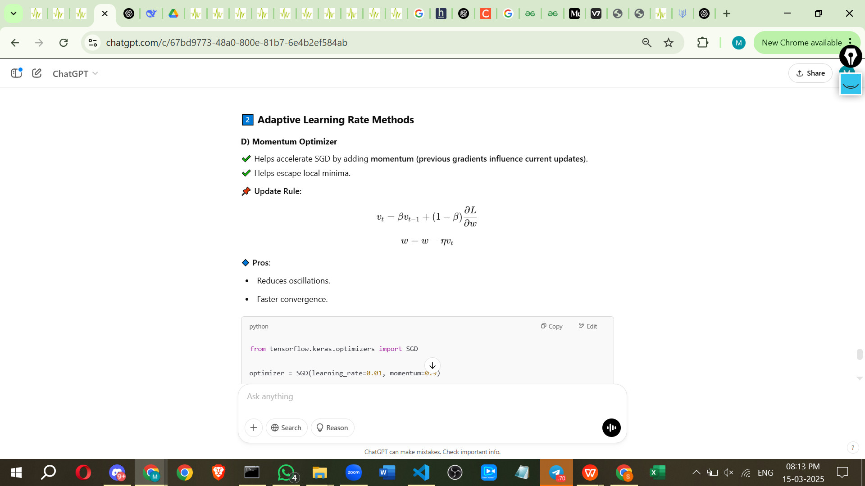
https://www.geeksforgeeks.org/optimization-rule-in-deep-neural-networks/

Slide 51


Adagrad (Adaptive Gradient Descent) Deep Learning Optimizer
The adaptive gradient descent algorithm is slightly different from other gradient descent algorithms. This is because it uses different learning rates for each iteration. The change in learning rate depends upon the difference in the parameters during training.
The more the parameters get changed, the more minor the learning rate changes. This modification is highly beneficial because real-world datasets contain sparse as well as dense features.
So it is unfair to have the same value of learning rate for all the features. The Adagrad algorithm uses the below formula to update the weights. Here the alpha(t) denotes the different learning rates at each iteration, n is a constant, and E is a small positive to avoid division by 0.
The benefit of using Adagrad is that it abolishes the need to modify the learning rate manually. It is more reliable than gradient descent algorithms and their variants, and it reaches convergence at a higher speed.

Slide 52
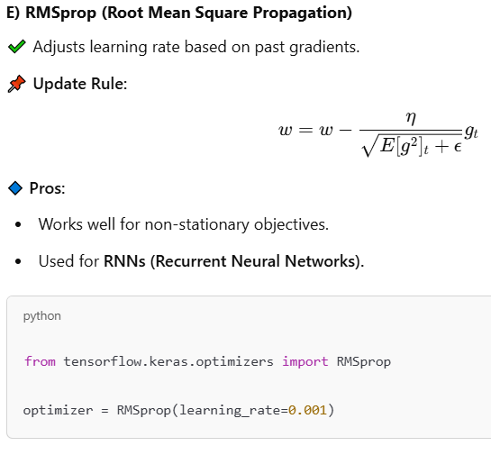
🔹 (3) RMSprop (Root Mean Square Propagation)
✔ Idea: Uses a moving average of squared gradients to adjust learning rates adaptively.
✔ Solves the vanishing/exploding gradient problem
✔ Pros: Works well for RNNs and deep networks.
✔ Cons: Requires tuning decay rate β.
4. Which Optimizer Should You Use?
Scenario | Best Optimizer
General deep learning | Adam (fast, adaptive)
Large-scale NLP (Transformers) | AdamW (prevents overfitting)
Simple problems (Regression, MLPs) | SGD
Image classification (CNNs) | SGD + Momentum / Adam
Recurrent Neural Networks (RNNs, LSTMs) | RMSprop / Adam

Slide 53
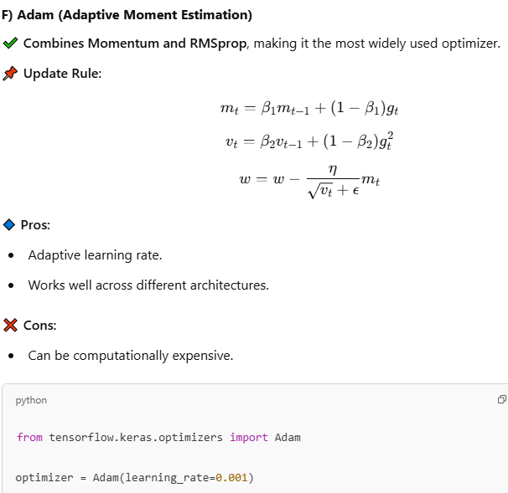
🔹 (4) Adam (Adaptive Moment Estimation) [MOST POPULAR]
✔ Combines Momentum + RMSprop → adaptive learning rate + velocity smoothing
✔ Pros: Fast convergence, works well for most problems.
✔ Cons: Can sometimes overfit or not generalize well.
🔹 (5) AdamW (Adam with Weight Decay) [BETTER THAN ADAM]
✔ Fixes Adam's tendency to overfit by decoupling weight decay from gradient updates.
✔ Used in Transformers (e.g., BERT, GPT models).
https://www.geeksforgeeks.org/deep-learning/adam-optimizer/
https://www.analyticsvidhya.com/blog/2021/10/a-comprehensive-guide-on-deep-learning-optimizers/

Slide 54
5. Code Example (Comparing Optimizers in TensorFlow/Keras)
6. Key Takeaways
✅ SGD is simple but slow.
✅ Momentum helps accelerate training.
✅ RMSprop is useful for RNNs.
✅ Adam is the most commonly used optimizer.
✅ AdamW is the best choice for large models like Transformers.
Would you like a comparison plot of optimizers on a dataset? 🚀
📌 Which Optimizer Should You Use?
For small datasets → SGD or Mini-batch GD
For deep networks → Momentum or Adam
For RNNs (sequential data) → RMSprop or Adam
For large-scale datasets → Adam (most recommended)
📌 Comparison Table
Optimizer | Pros | Cons | Best Used For
GD | Guarantees convergence | Slow for large datasets | Simple problems
SGD | Fast, works for online learning | Noisy, unstable | Large-scale datasets
Mini-batch GD | Efficient, stable | Requires tuning batch size | Most deep learning tasks
Momentum | Reduces oscillations | Can overshoot | Deep networks
RMSprop | Adapts learning rate | Needs tuning | RNNs, NLP
Adam | Adaptive, robust | Slightly expensive | CNNs, RNNs, GANs

